Slide 1
Capstone Project
Hotel Booking Analysis

Slide 2

Content
Importing Libraries
Data Cleaning
Data Understanding
Data validation and Publishing
Univariable Study
Conclusion

Slide 3
Problem Statement :
For this project we will be analyzing Hotel Booking data. This data set contains looking information for a city hotel and a resort hotel , and includes information such as when the booking was made, length of stay ,the number of adults ,children and/or babies, and the number of available parking spaces.
Hotel industry is a very volatile industry and the bookings depends on above factors and many more.
The main objective behind this project is to explore and analyze data to discover important factors that govern the bookings and give insights to hotel management , which can perform various compaigns to boost the business and performance.

Slide 4
Data Understanding
Data Cleaning
Exploratory Data Analysis (EDA)
Work Flow :

Slide 5
Importing Libraries :
First we need to import the libraries which will be used for Data analyzing and understanding.
import pandas as pd
import numpy as np
import matplotlib.pyplot as plt
%matplotlib inline
import seaborn as sns
from datetime import datetime
from datetime import date
import warnings
warnings.filterwarnings('ignore') #Used when finding the outliers
These are the we have used.

Slide 6
Data Summary :
Data set name - Hotel Booking Analysis
Columns –
hotel
Provided Hotel type
Resort or City hotel
is_canceled
Value provided information about cancellation by customer.
If canceled = 1
If not canceled = 0
lead_time
The Booking Lead Time is the number of days between the time a guest books their room and the time they are scheduled to arrive at the hotel.
arrival_date_year
Year of arrival of the Customer.
arrival_date_week_number
week number of arrival of the Customer.

Slide 7
arrival_date_day_of_month
Month of arrival of the Customer.
stays_in_weekend_nights
Number of weekend nights (Saturday night or Sunday night) the guest stayed or booked to stay at the hotel.
stays_in_week_nights
Number of week nights (Monday to Friday) the guest stayed or booked to stay at the hotel.
adults
Number of adults stayed or booked to stay at the hotel
children
Number of children stayed or booked to stay at the hotel
babies
Number of babies stayed or booked to stay at the hotel
meal
Type of meals Booked.
  BB: Bed & Breakfast
  HB: Half Board (Breakfast and Dinner normally)
  FB: Full Board (Beakfast, Lunch or Dinner)
  Undefined/SC: Rooms only packages without meals.

Slide 8
countries
Country of origin of the customer.
Country name provided based on ISO 3166 country codes.
market_segment
Market segment distinction
Provides source of information through which customer booked
Term "TA" - "Travel Agent"
Term "TO" - "Tour operators"
Both "TA" and "TO" considers as same kind of market segment.
distribution_channel
also called "marketing channel"
Is the Network through which customer booked.
is_repeated_guest
Value provided information about whether the customer is new or old.
If new to the hotel = 1
If not new to the hotel = 0
previous_cancellations
Number of bookings previously canceled by the customer, Before current booking.

Slide 9
previous_bookings_not_canceled
Number of bookings previously not canceled by the customer, Before current booking.
reserved_room_type
Type of room reserved stored in alphabat codes.
assigned_room_type
Type of room reserved stored in alphabat codes.
booking_changes
Number of changes made to the booking until check-in or completely canceled.
deposit_type
The purpose of the advance deposit is to guarantee a reservation
There are 3 types of deposit,
  'No Deposit' - No deposit need by the hotel on booking
  'Refundable' - Deposit that can be refunded while vacating the room, Which included in total Room-stay cost.
  'Non Refundable' - Amount paid that can't be refunded once paid Which included in total Room-stay cost.
agent
Unique ID code of the Travel agent through which booking made.

Slide 10
company
Unique ID code of the company or entity who made booking and responsible for payment.
days_in_waiting_list
Number of days the booking was in the waiting list before it was confirmed to the customer.
customer_type
'Transient' - Simply individual guests requiring a short stay at the hotel
'Contract' - Agreement between hotel authority and customer to requiring volume room bookings on contract basis.
'Transient-Party' - Booking is Transient and associated with other transient booking
'Group' - Multiple rooms are booked under single customer responsibility
adr
The Average Daily Rate (ADR) is the price to be paid by customer for staying per day/night in the room.
required_car_parking_spaces
Number of vehicle space requested by customer while booking.
total_of_special_requests
Total number of special request made by customer while booking.

Slide 11
reservation_status
Reservation status when data created.
It stored in three types:
  'Check-Out' - Customer already vacated from the room booked.
  'Canceled' - Booking was canceled by the customer.
  'No-Show' - Room was booked, yet customer neither 'Checked-in' nor 'Canceled'
reservation_status_date
Date on which reservation_status checked

Slide 12
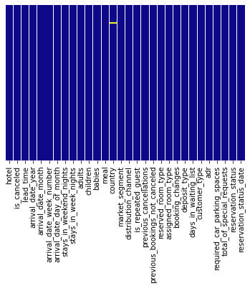
Data Cleaning :
We can see only a few columns had null values.
-According to observation, we found the percentage's of null values highest in "agent" and "company" columns.
-Now, Dropping those columns with the highest number of null value as part of data cleaning

Slide 13
Still variables "children" and "country" has some mininum number of the null values
Hence, filling those null values with appropriate values.
That is,
  Filling the null values in the children column as "0"
  Filling the null values in the country with country name which has maximum count in the data.

Slide 14
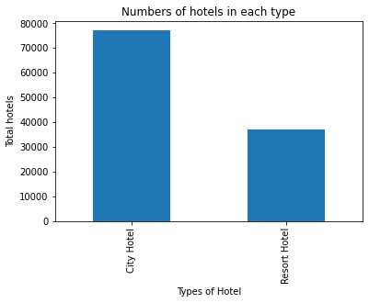
Data validation and Publishing
Univariable study:
1. Number of Bookings in each Hotel type
Observation:
Customer prefered City Hotel more than Resort Hotel

Slide 15
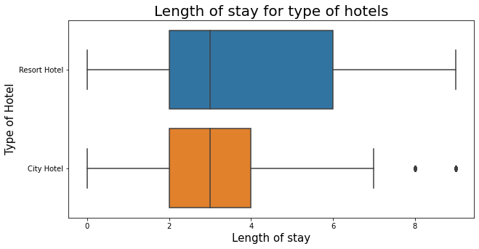
2. Length of stay in each hotel type Box plot
Observation :
- If we ignore the outliers, the maximum length of stay is more in resort type as resort is mostly used for vacation purpose.
- Median of both the hotels are approximately equal.

Slide 16
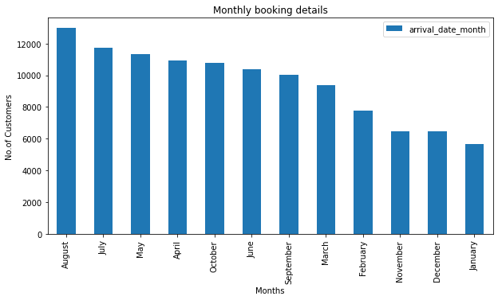
3. Number of Booking month-wise
Observation:
* Bookings in August is highest
* January found lowest numbers in booking counts.

Slide 17
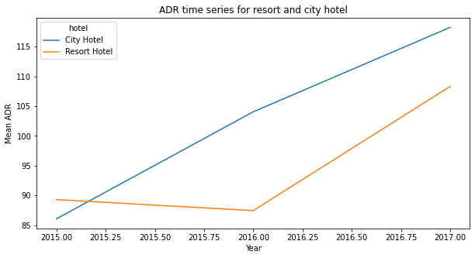
4. ADR for each hotel type according to year (Line Plot)
Observation:
City hotels has always higher (adr) than resort hotel.
If the trend continues like that, resort hotel (adr) showing maximum increased inclination which means in few years resort hotel adr will cross the city hotel.

Slide 18
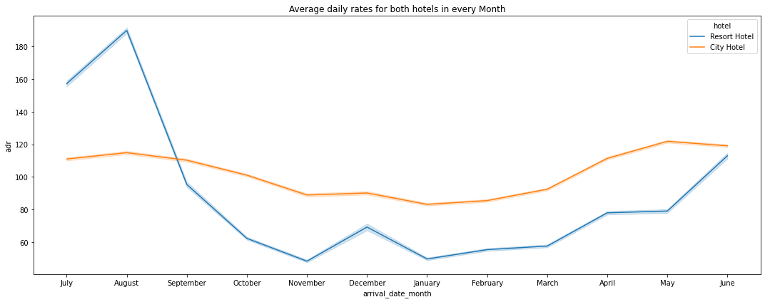
5. Average daily rates(adr) for both hotels in every month
Observation:
In the month of July and till the last week of August Resort hotels received more "adr" than City hotel
City hotel although dominating in 'adr' in remaining months of the year.

Slide 19
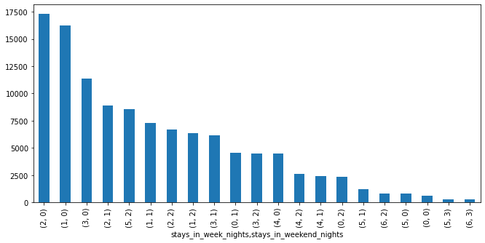
6. Stays in weekend and weekdays in hotels vs Bookings
Observation:
Maximum Booking done by customer for "2" weeknights stay and "0" weekend nights

Slide 20
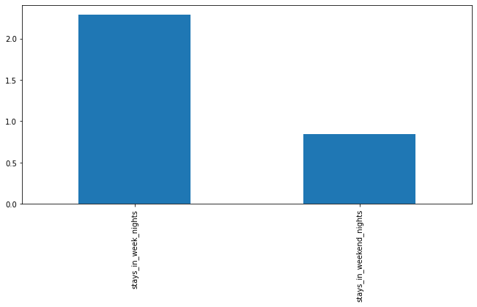
On-Further Observation :
Observation:
On average, customers booking for 2-3 week-nights stay and 1 weekend-nights stay

Slide 21
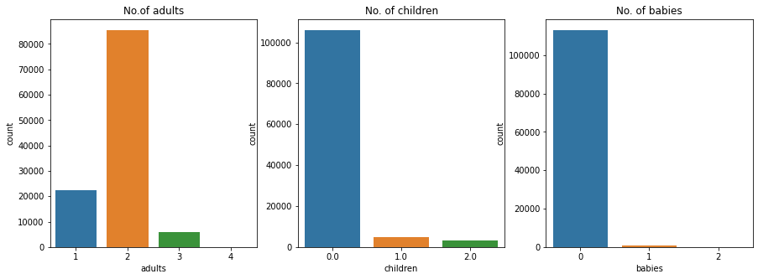
7. Count of adults , children ,babies in booking
Observation:
Bookings are mostly made for 2 adults with 1 children in combination

Slide 22
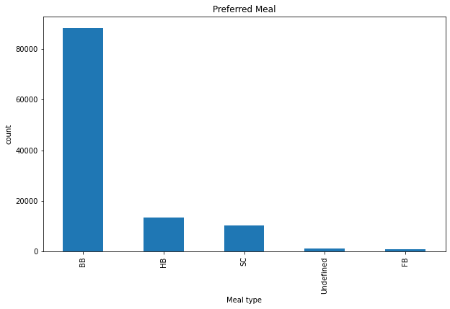
8. Preference of the meal by customer
Observation:
Customers of any type preferring "BB" Bed and breakfast type of meals.

Slide 23
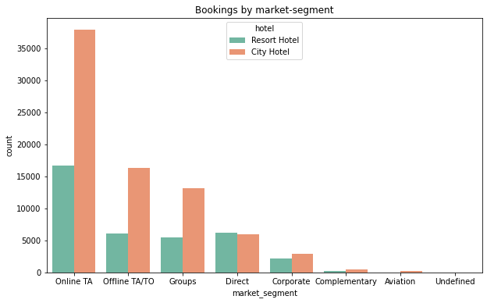
9. Top 10 country of origin of customer
Observation:
Travel agency (TA) or Tour operator (TO) Plays vital role in Hotel booking
Except "Direct bookings", all market-segment has more number of bookings in city hotel type.

Slide 24
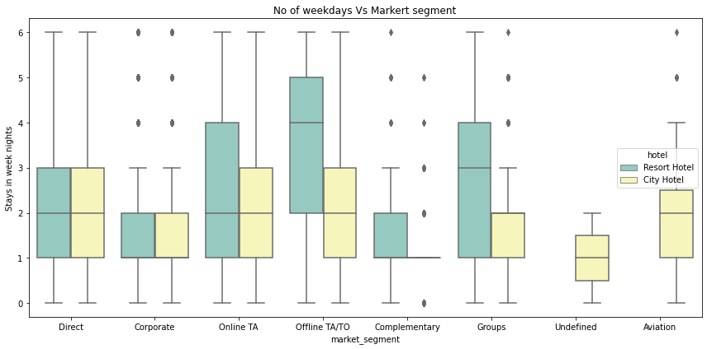
11. Number of Weekdays booked vs market segment
Observation:
Customer from direct market segment staying in same range numbers of week nights.
Offline TA/TO and Group market segment has some deviation over stays week-nights between Resort and City hotels
Undefined and Aviation market segment customer had not shown interest in the Resort Hotel

Slide 25
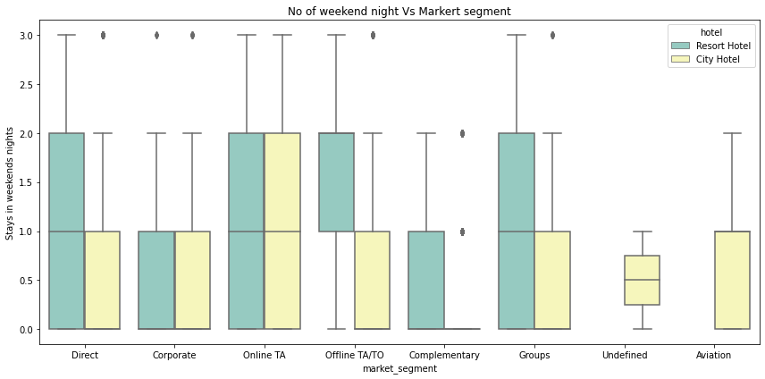
12. Number of Weekend nights booked vs market segment
Observation:
Direct market segment customer prefer to stay more weekend nights in the Resort Hotel type.
Online TA customer equally preferring between Resort and City hotels.

Slide 26
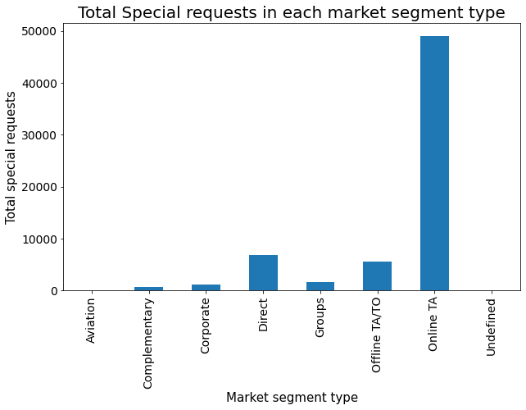
13. Total special request in each type of market segment

Slide 27
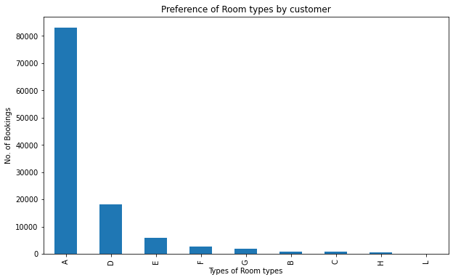
14. Preference of Room types by customer
Observation:
Room type of "A" preferred mostly by customers
Also it should be note the maximum numbers of booking done in the rooms type of A,D,E than others with minimum number of bookings

Slide 28
15. Rooms assigned to customer vs Rooms Reserved by the customer
assigned_room_type | A | B | C | D | E | F | G | H | I | K | L
reserved_room_type
A | 85.0 | 1.0 | 2.0 | 9.0 | 1.0 | 0.0 | 0.0 | 0.0 | 0.0 | 0.0 | 0.0
B | 9.0 | 89.0 | 0.0 | 0.0 | 0.0 | 0.0 | 1.0 | 0.0 | 0.0 | 0.0 | 0.0
C | 1.0 | 0.0 | 95.0 | 1.0 | 0.0 | 0.0 | 1.0 | 1.0 | 1.0 | 0.0 | 0.0
D | 2.0 | 0.0 | 0.0 | 92.0 | 4.0 | 1.0 | 0.0 | 0.0 | 0.0 | 0.0 | 0.0
E | 0.0 | 0.0 | 0.0 | 0.0 | 90.0 | 7.0 | 2.0 | 0.0 | 1.0 | 0.0 | 0.0
F | 0.0 | 0.0 | 0.0 | 0.0 | 1.0 | 94.0 | 4.0 | 0.0 | 0.0 | 0.0 | 0.0
G | 0.0 | 0.0 | 0.0 | 0.0 | 0.0 | 1.0 | 97.0 | 0.0 | 1.0 | 0.0 | 0.0
H | 0.0 | 0.0 | 0.0 | 0.0 | 0.0 | 0.0 | 2.0 | 97.0 | 1.0 | 0.0 | 0.0
L | 17.0 | 17.0 | 17.0 | 0.0 | 0.0 | 17.0 | 0.0 | 17.0 | 0.0 | 0.0 | 17.0
All | 63.0 | 2.0 | 2.0 | 21.0 | 6.0 | 3.0 | 2.0 | 1.0 | 0.0 | 0.0 | 0.0
Observation:
-From crosstab, relationship of reserved and assigned rooms found.
Hotel ensured that, 97.0 % of Customer getting the same room type as reserved in room type "G" and "H"
-Lowest possibility of getting the same room type when reserved in room type "L"
AS we know, maximum number of booking done for room type "A" which ensured 85.0% of same room as reserved by the customer

Slide 29
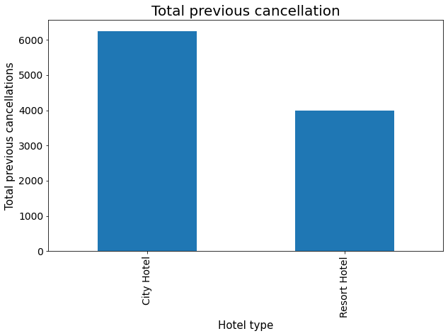
16. Total previous cancellation and not cancellation in each hotel type

Slide 30
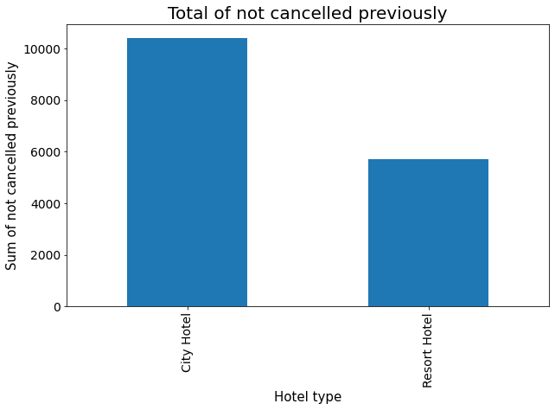
-Total number of previously not cancelled booking is more in city hotel than a resort hotel.
-The city hotel is used more frequently compared to resort hotel thus the canceled and not canceled booking will be more in city hotel.

Slide 31
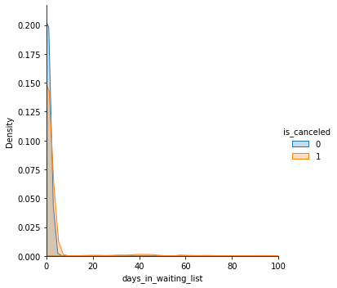
17. waiting time vs cancellation
Observation:
As found from the density,
Increase in days in waiting list increasing the cancellation of the booking

Slide 32
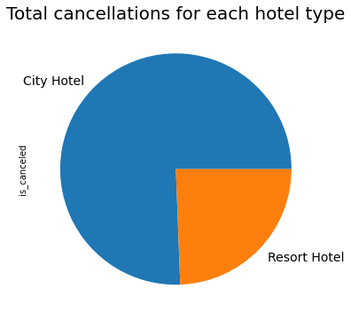
18. Total cancellations for each hotel type
Observation:
Percentage cancellation in city hotel is 41.09%.
Percentage cancellation in resort hotel is 27.66%

Slide 33
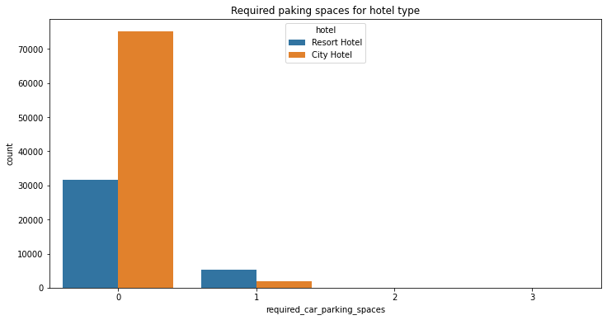
19. Required Parking spaces vs hotel type
Observation:
Mostly customers not demanding parking space.
If demanding means, mostly in the number "1", that too maximum required in the Resort hotel.

Slide 34
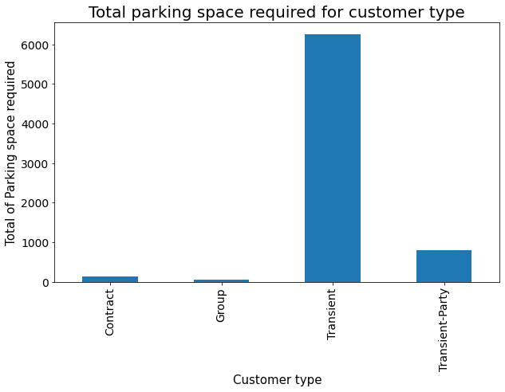
20. Sum of parking space according to type of booking
Observation:
-When customer type is Transient that means the stay is more few days so it is possible that customer bringing his/her own vehicle that's why the parking space required it high for Transient
-In contract and group booking customer will probably take a hired vehicle form hotel or from somewhere else that's why they do not need parking space.

